Slide 1


To My Presentation
Presentation Title: Environment Pollution
Submitted To Submitted By
Name: Md. Rashid Al Asif Name: Tithi Biswas
Assistant Professor Batch: 50
Department of Computer Science & Engineering Roll: 01-50-16
University of Barishal University of Barishal

Slide 2

Table of Content:
Definition Of Environment Pollution
Components of Environment
Types of Environment Pollution
Causes of Environment Pollution
Description of Different Types of Pollution
How to Mitigate Environment Pollution

Slide 3
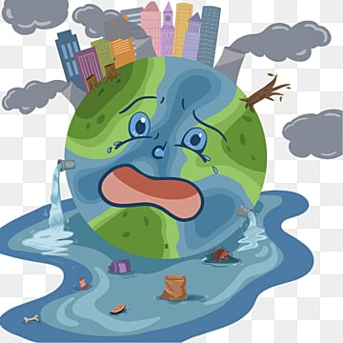
Definition of Environment Pollution:
Environmental pollution is unwarranted disposal of mass or energy into earth’s natural resource pool such as water, land, or air that results in long- or short-term detriment to the atmosphere and its ecological health to negatively impact the living beings and their life both quantitatively and qualitatively.

Slide 4
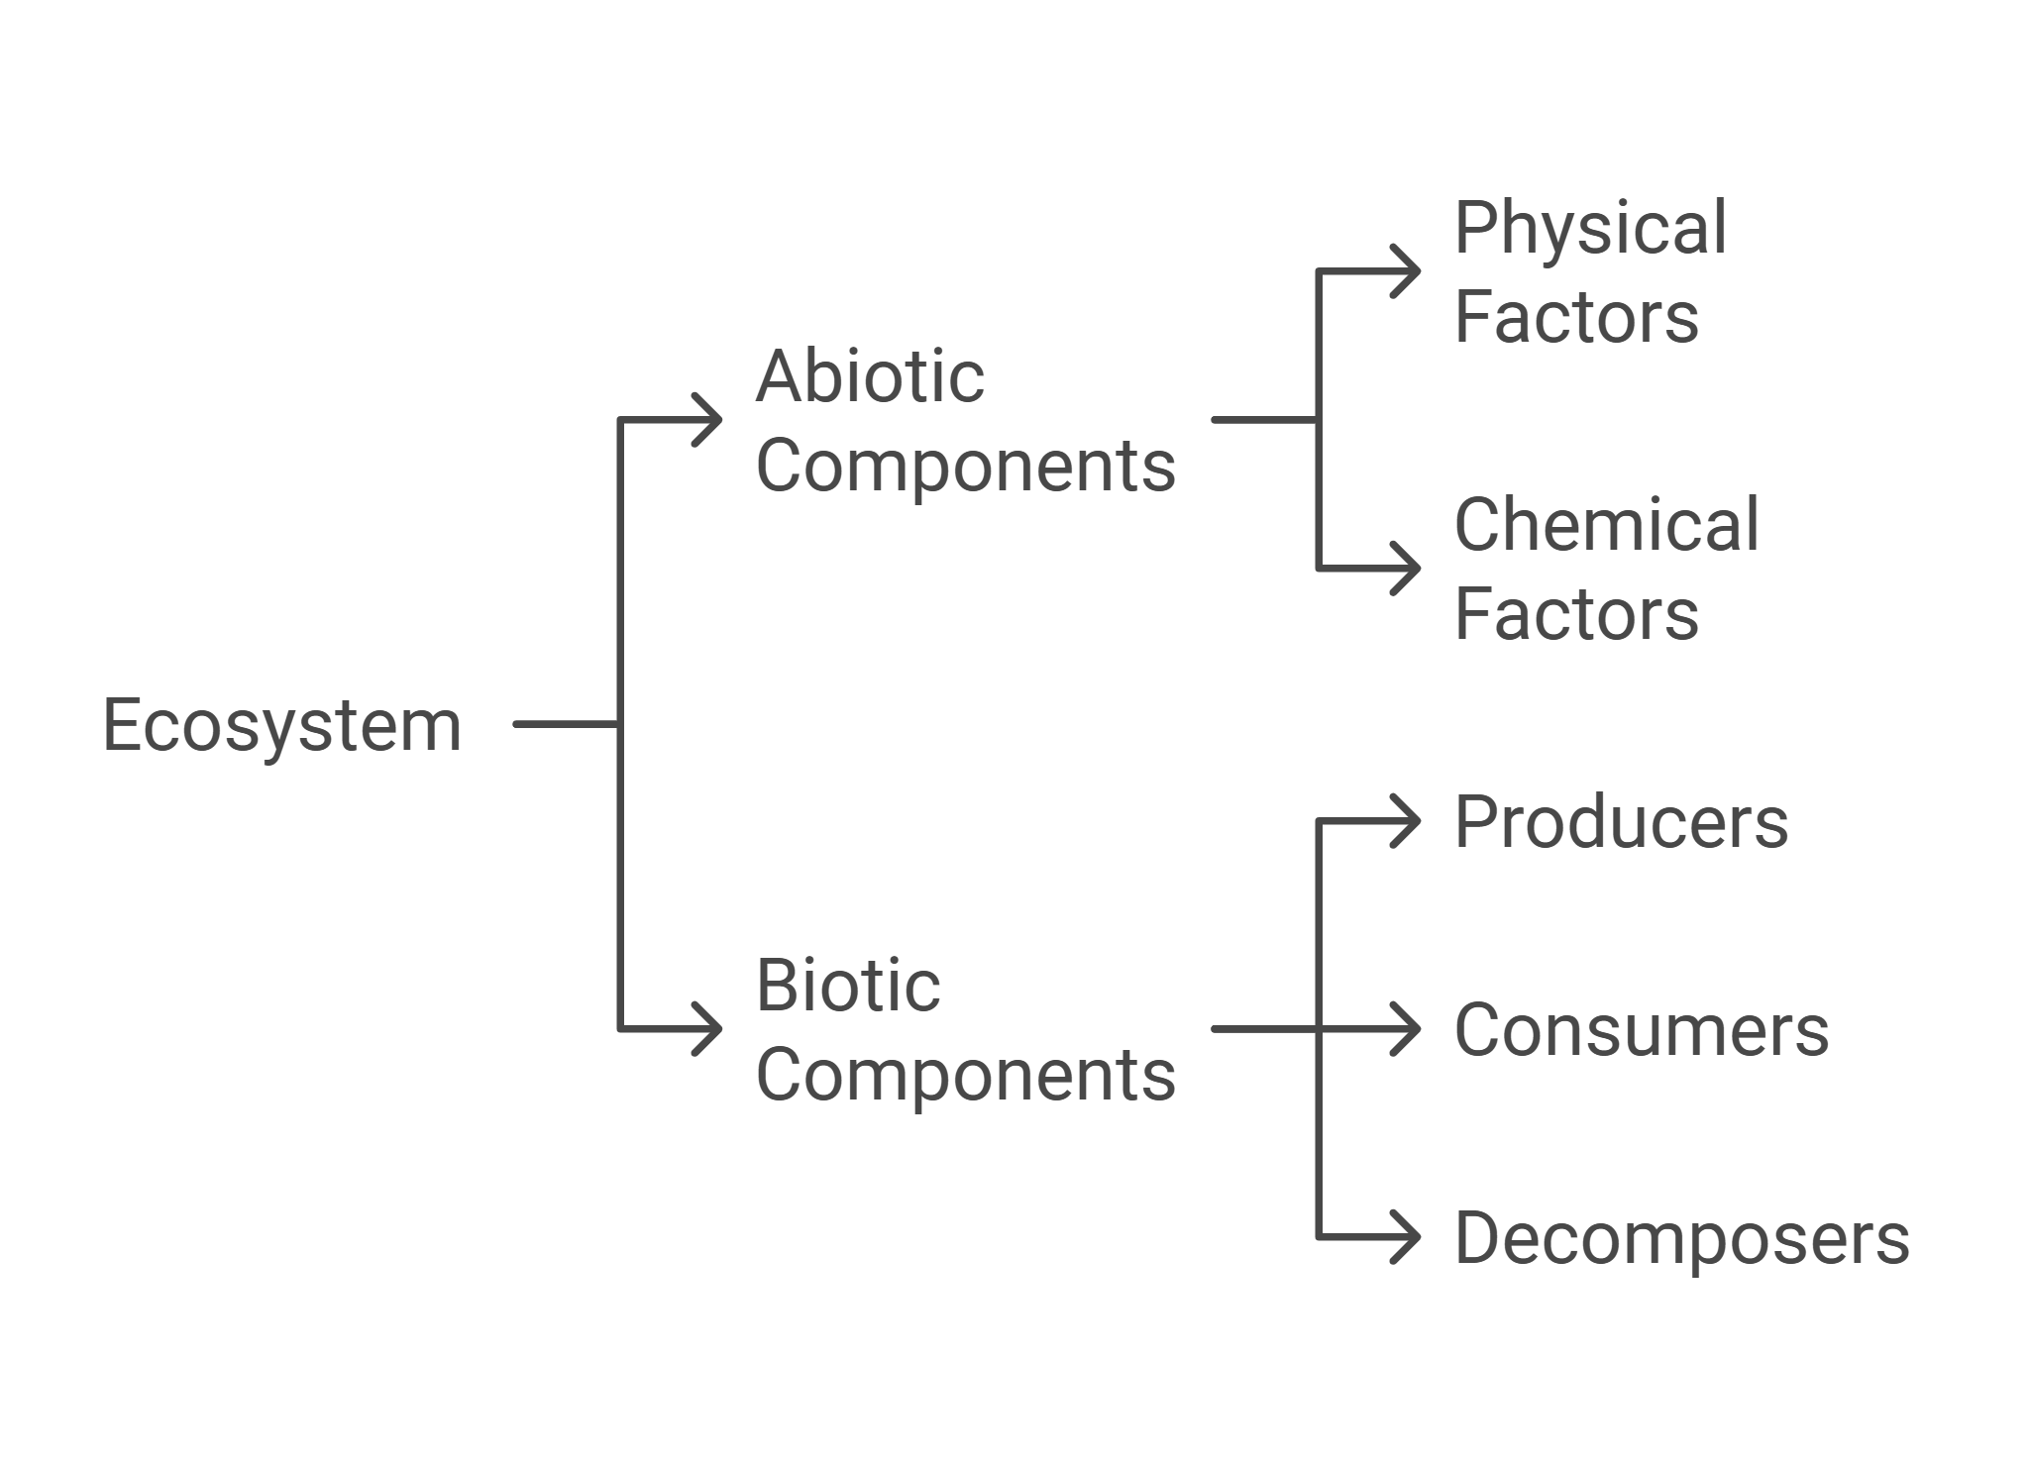
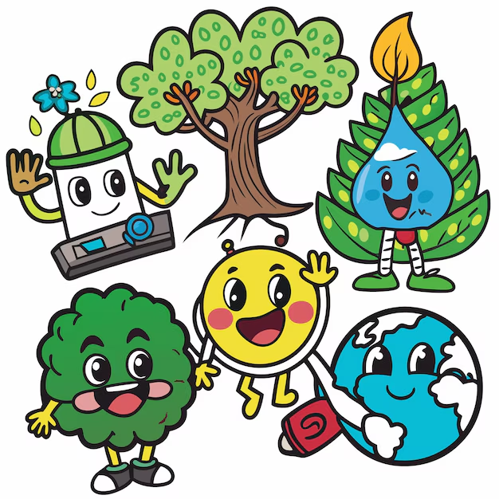
Components of Environment:

Slide 5
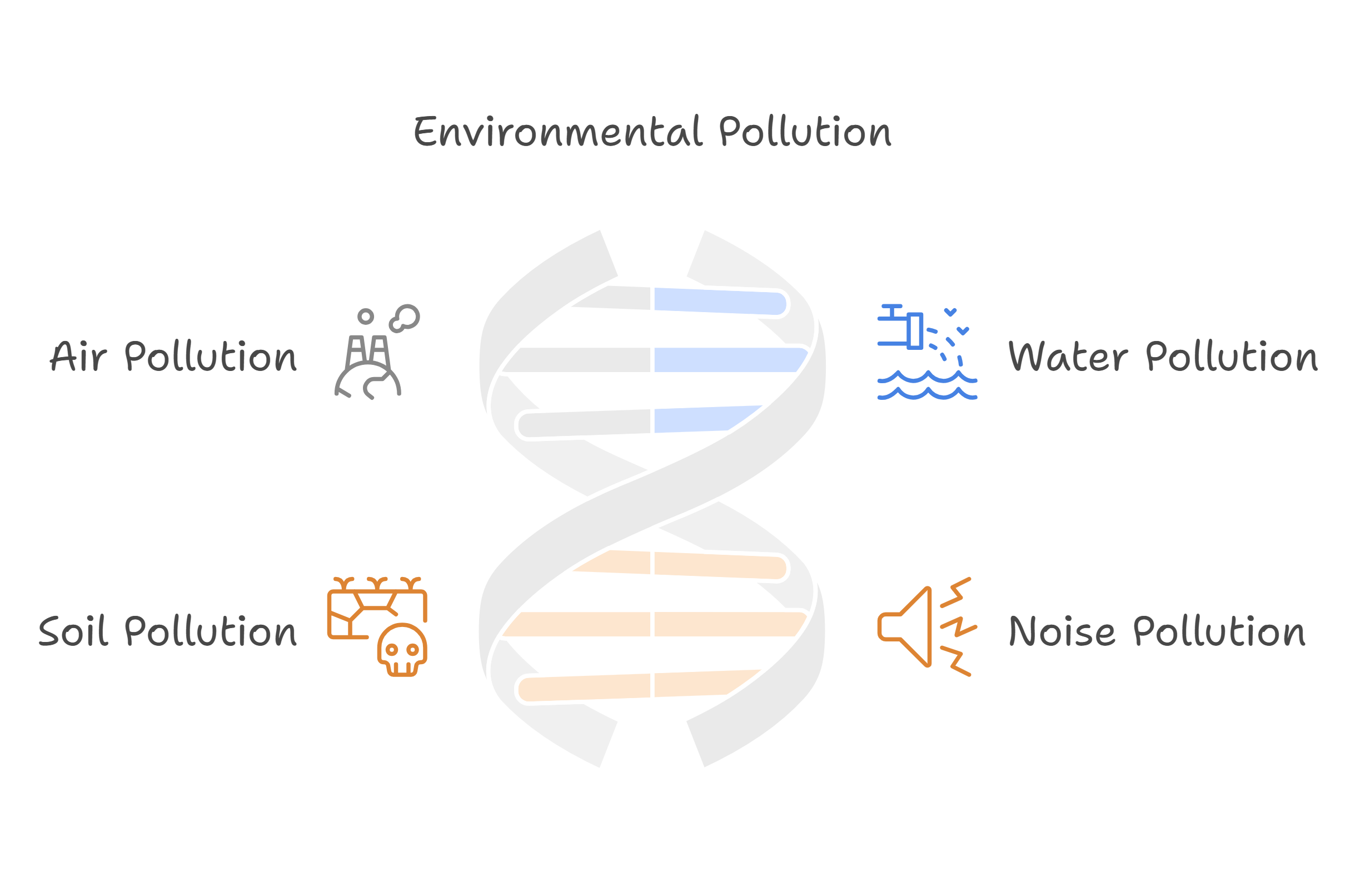
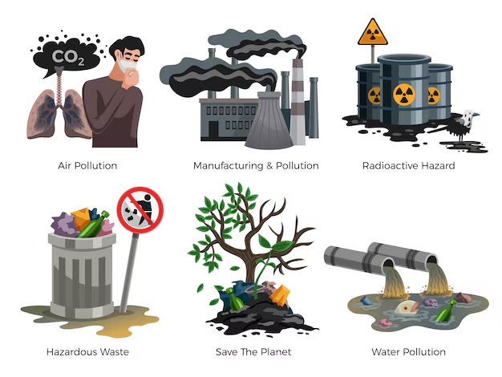
Types Of Environment Pollution:

Slide 6
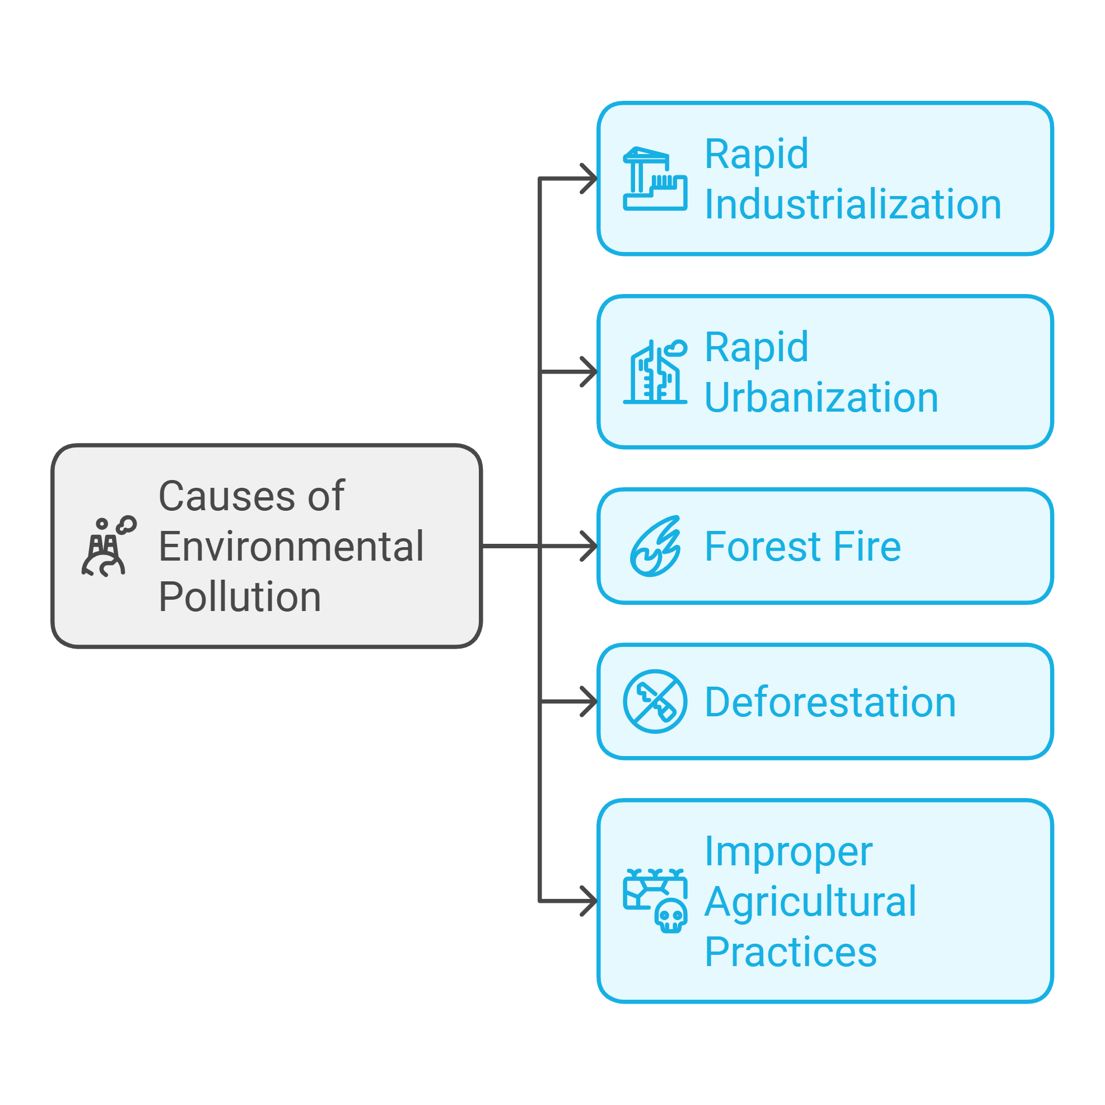
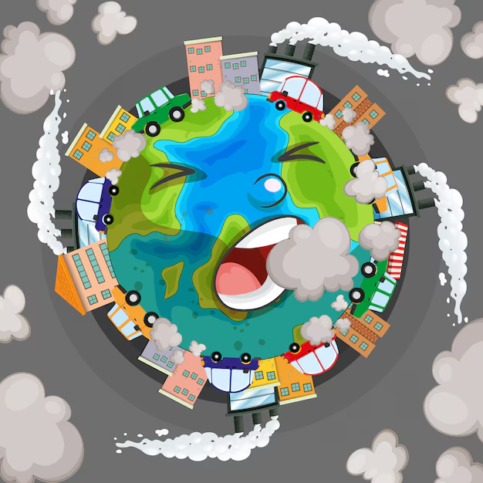
Causes Of Environment Pollution:

Slide 7
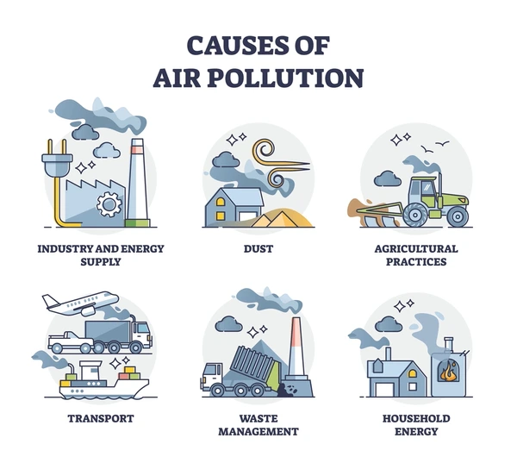
Air Pollution:
Air pollution is the introduction of chemicals, particulate matter or biological materials that cause harm or discomfort to humans or other living organisms or cause damage to the natural environment or built environment into the atmosphere.

Slide 8
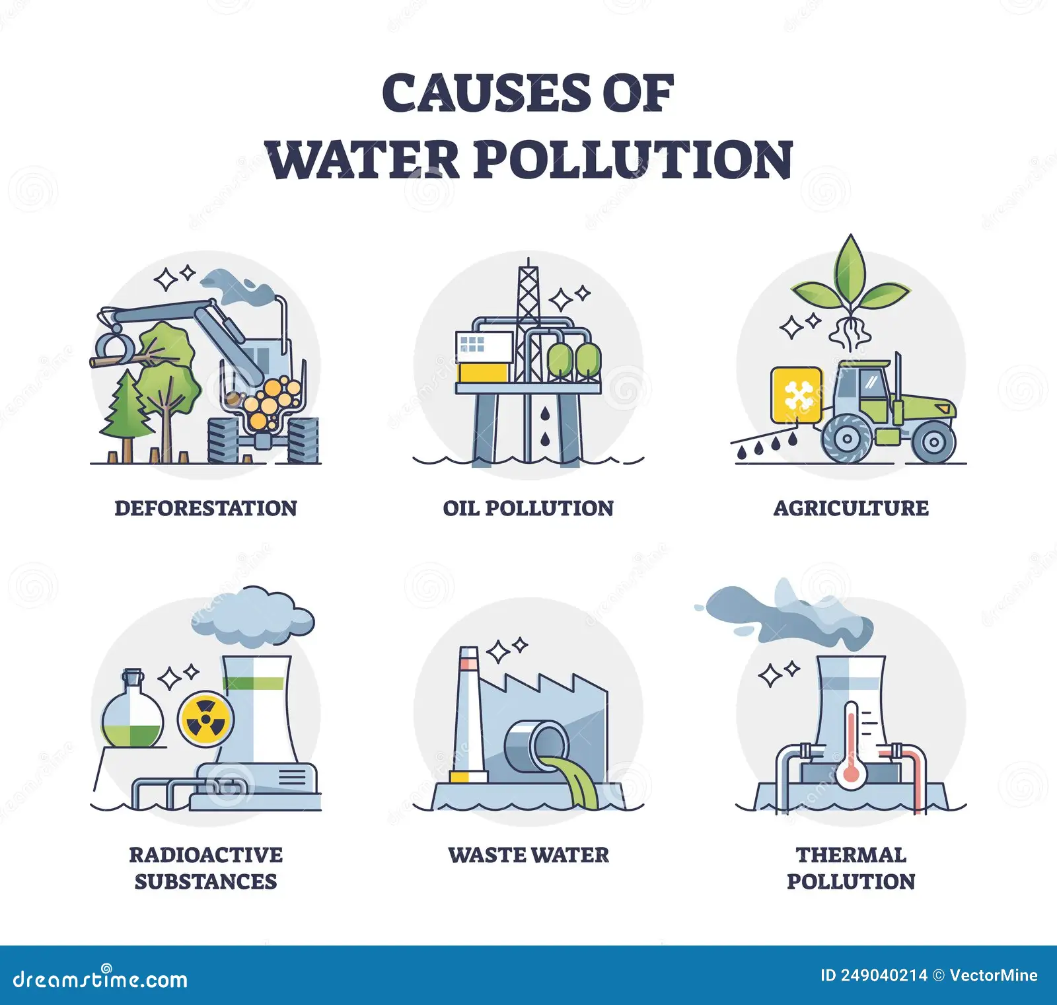
Water Pollution:
Water pollution can be defined as alteration in physical ,chemical or biological characteristics of water through natural and human activities and making it unsuitable for its designated use.

Slide 9
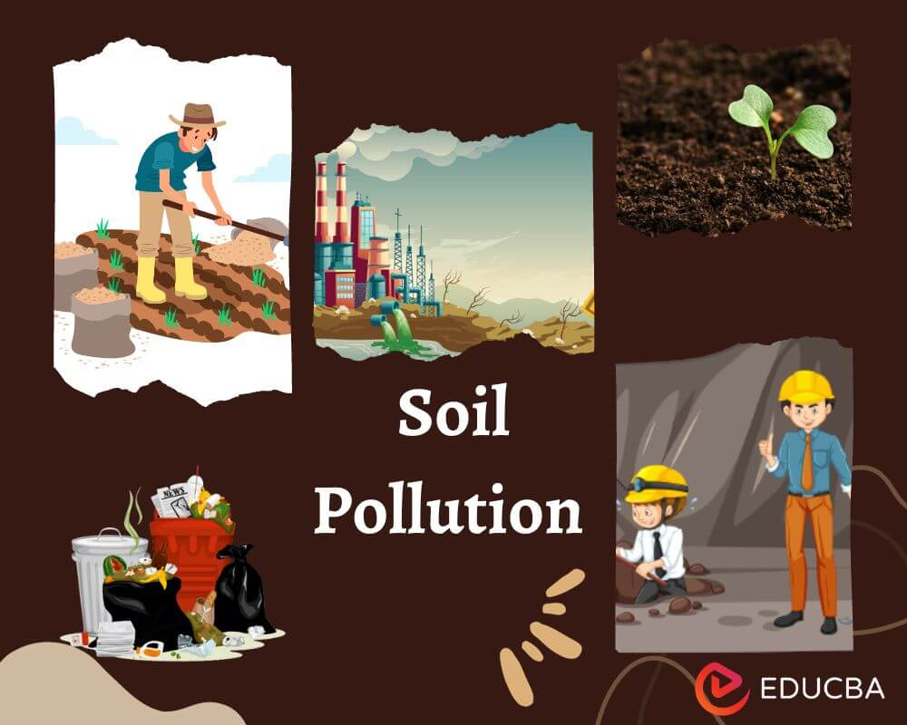
Soil Pollution:
Soil pollution is the demolition of Earth’s land surfaces often caused by human activities and their misuse of land resources. It occurs when waste is not disposed property.

Slide 10
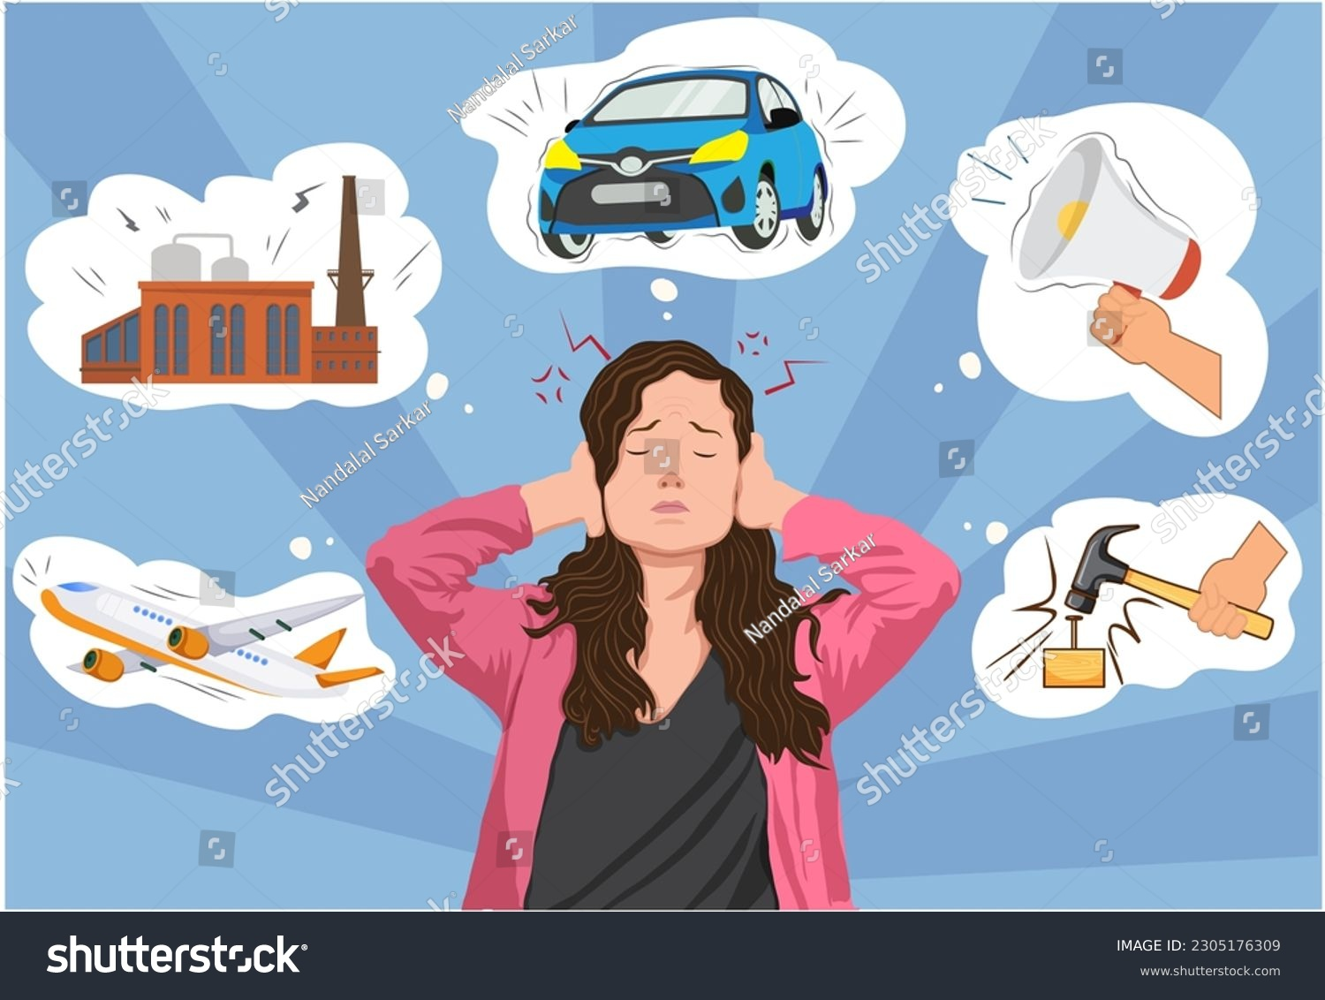
Noise Pollution:
Noise pollution is excessive ,displeasing human ,animal or machine-created environmental noise that disrupts the activity or balance of human or animal life.

Slide 11
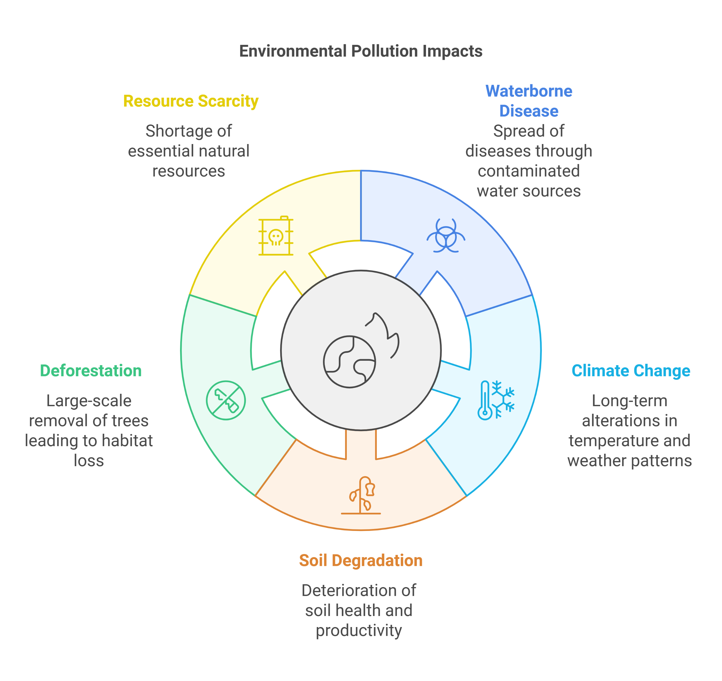
Effects of Environment Pollution:

Slide 12

Impact of Environment Pollution On Earth:

Slide 13
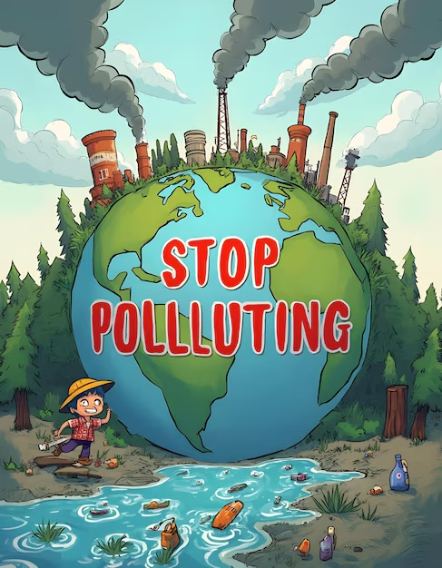
How to Mitigate Environment Pollution?
Reduce driving
Use less energy
Use renewable energy
Reduce waste
Plant tress
Conserve Water
Use Environmentally friendly products

Slide 14

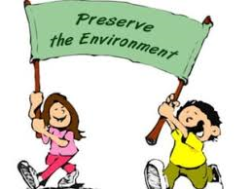
Thank You

